Slide 1
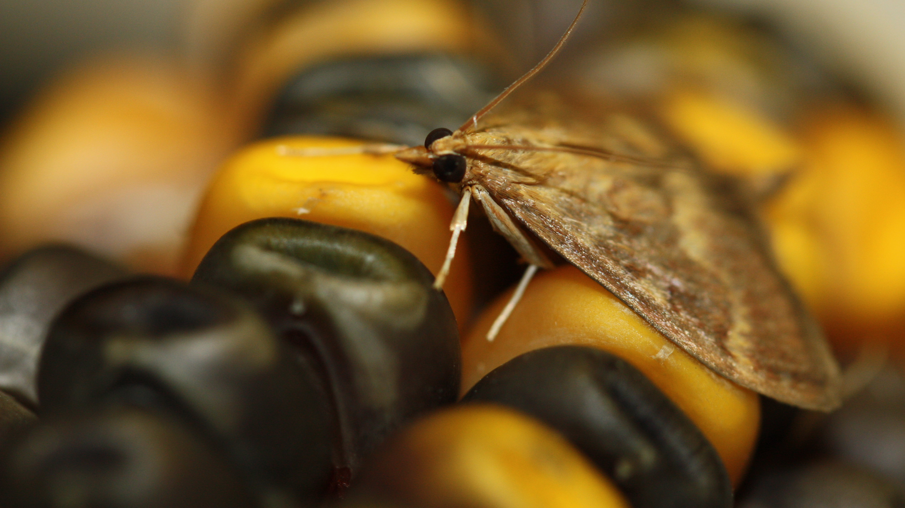
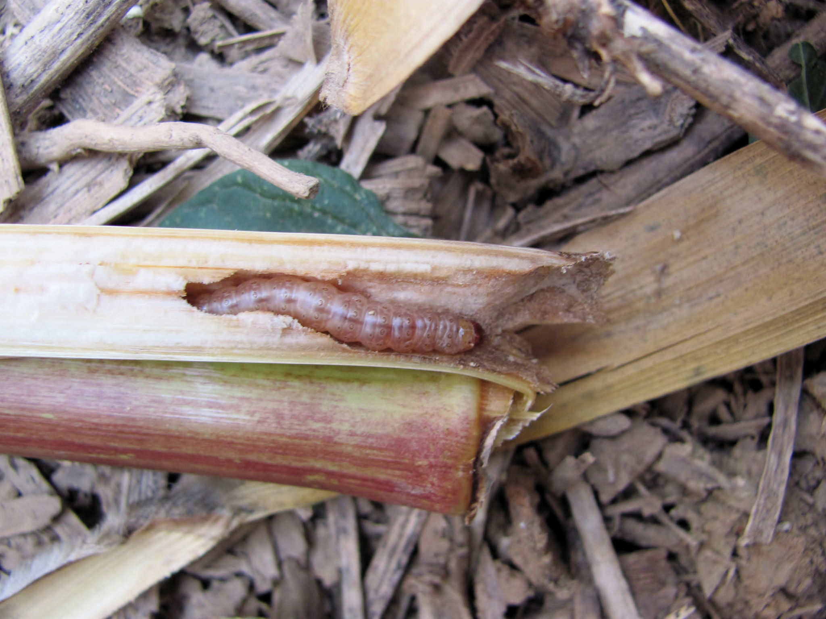
European corn borer, ECB (Ostrinia nubilalis)
Currently a major agricultural pest in corn
$1 Billion in annual losses due to yield reduction and pest management
DIAPAUSE
Image: Eric Bohnenblust/Penn State
Notes:
Crop losses and management of ECB in 2001 exceeded 1bil dollars
threshold: 10 moths in black light trap

Slide 2
Photoperiod
Used by temperate animals to prepare for winter
The number of daylight hours in 24hr cycle
Historically, photoperiod has reliably predicted seasonality
Summer: 6pm
Winter: 6pm
Notes:
Environmental conditions/resources are cyclic
Environmental cues are cyclic and consistent
Environmental cues are perceived by insects
Insects monitor environmental cues to predict changes in environmental conditions/resources
In temperate regions many insects rely on photoperiod

Slide 3


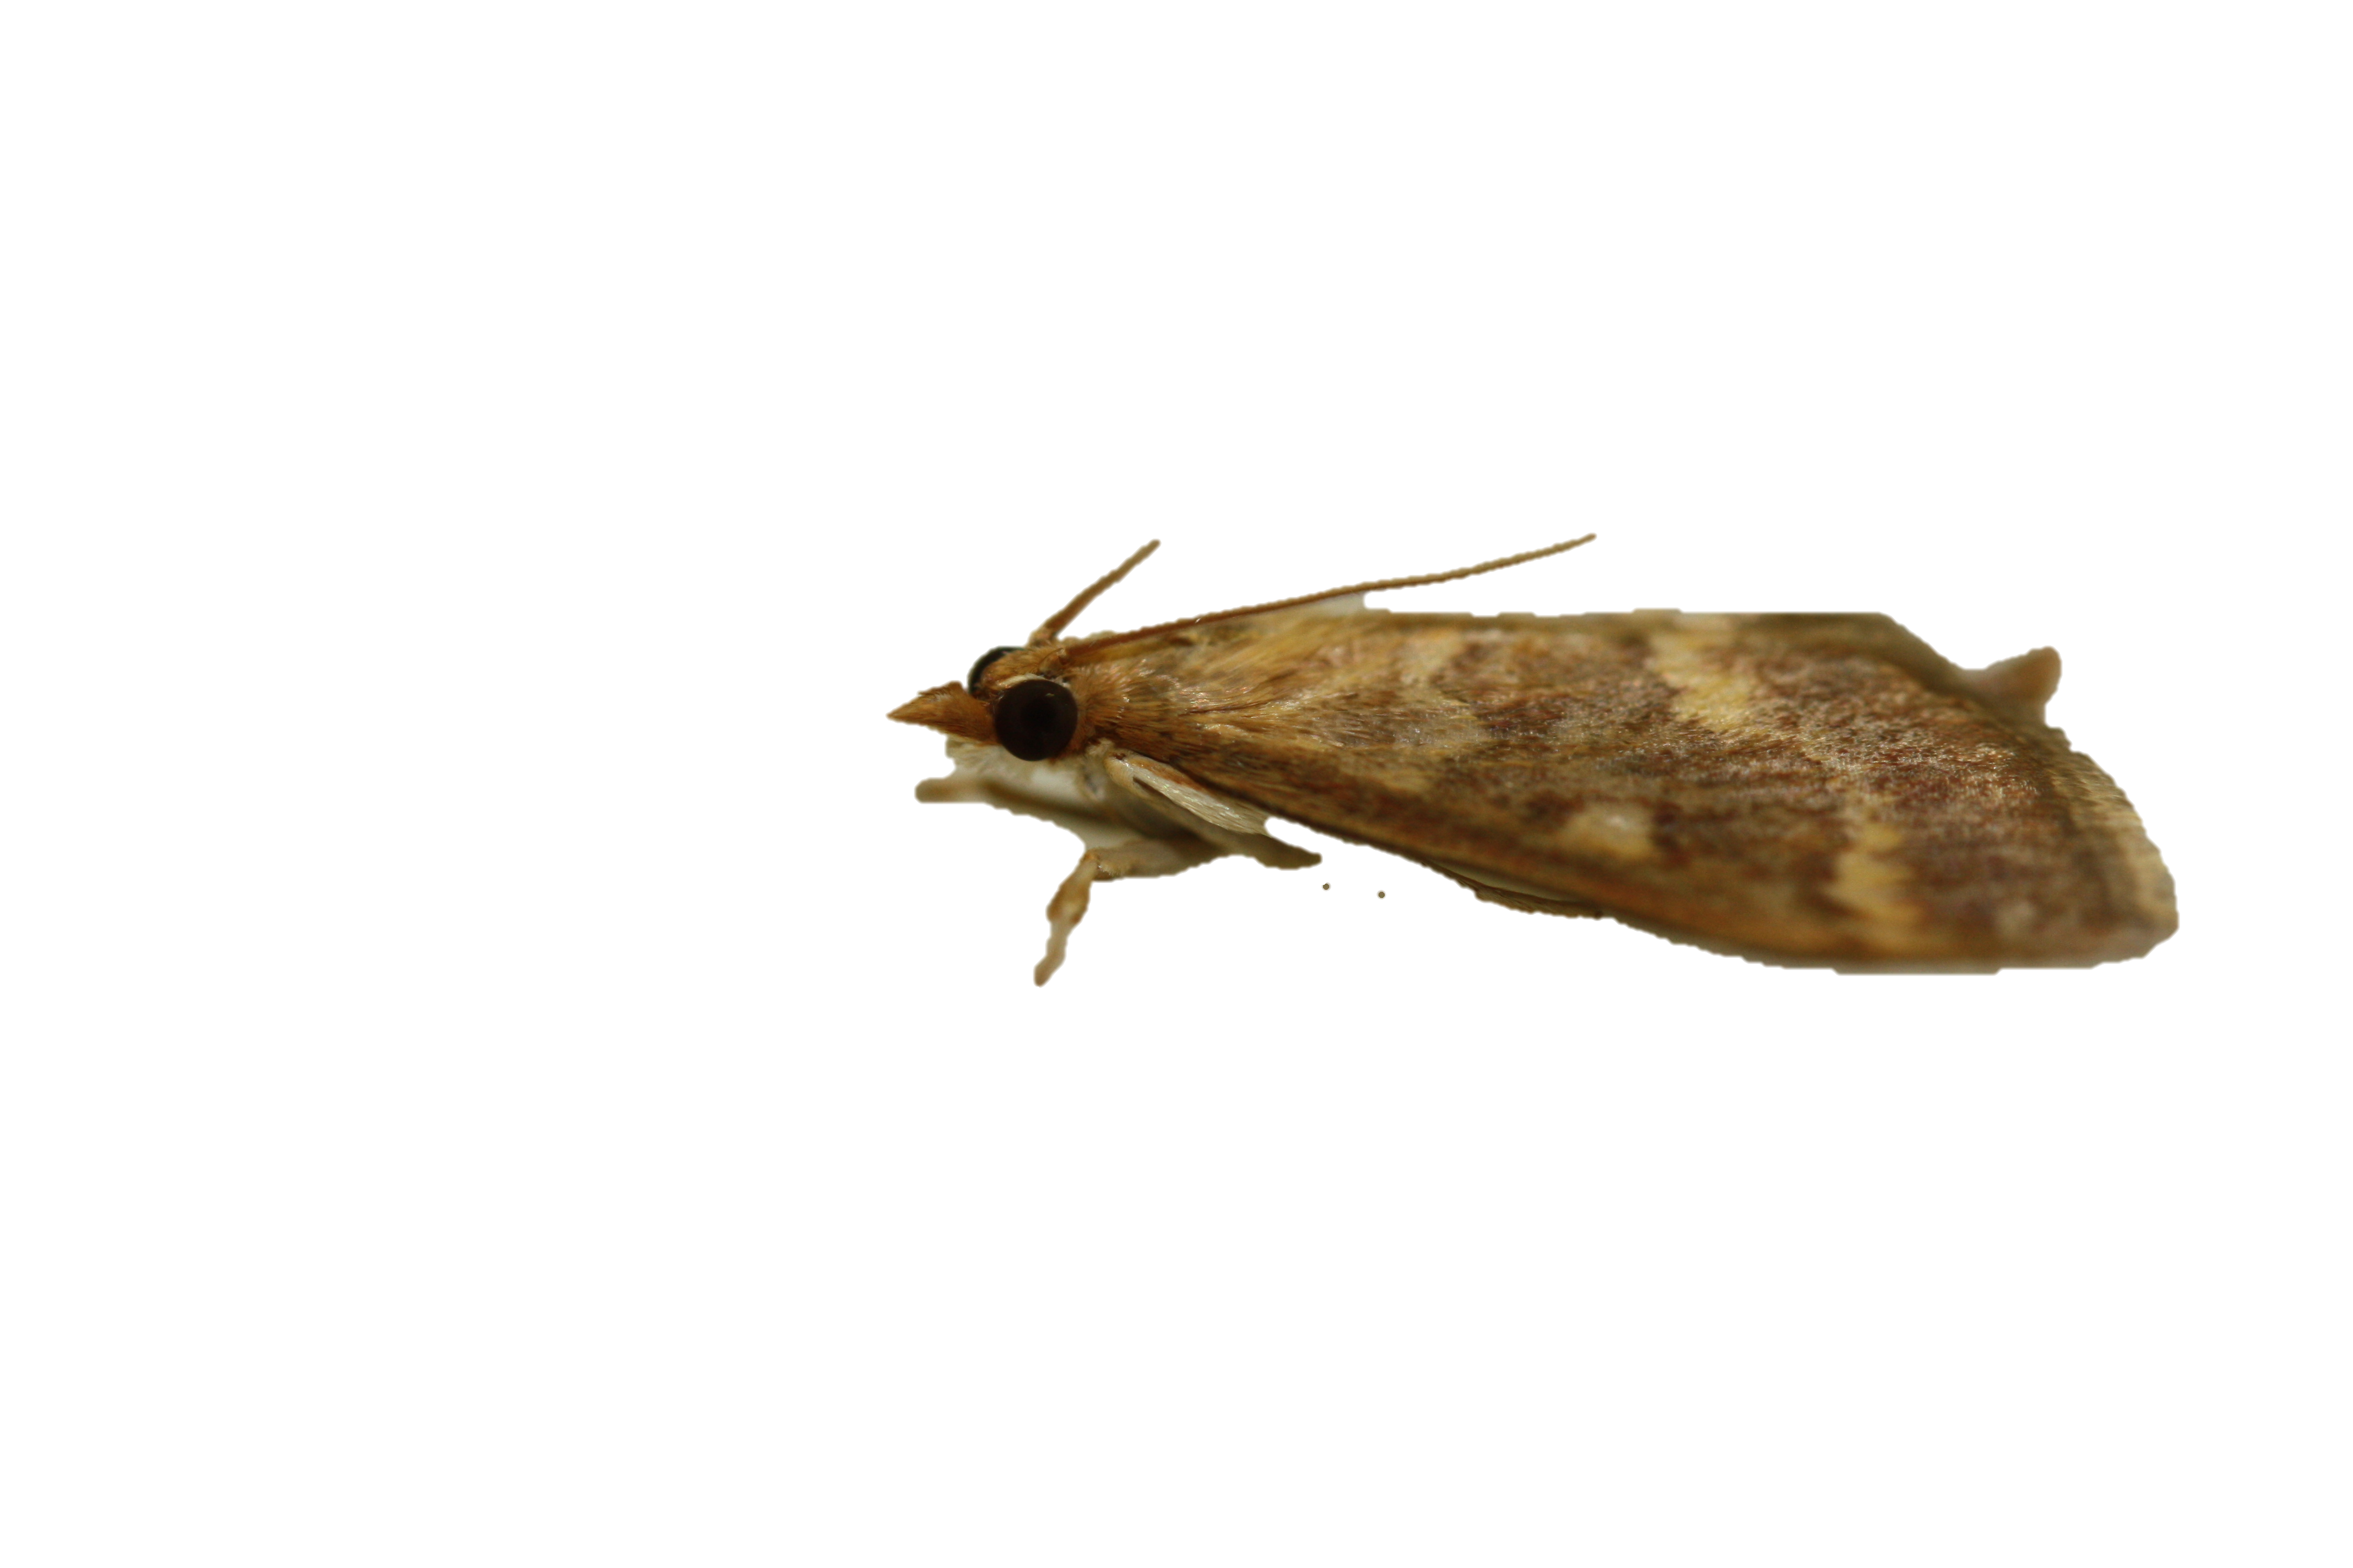
What season is it? Should I prepare for diapause?
?
?
?
?
?
?
?
?
?
?
?
?

Slide 4
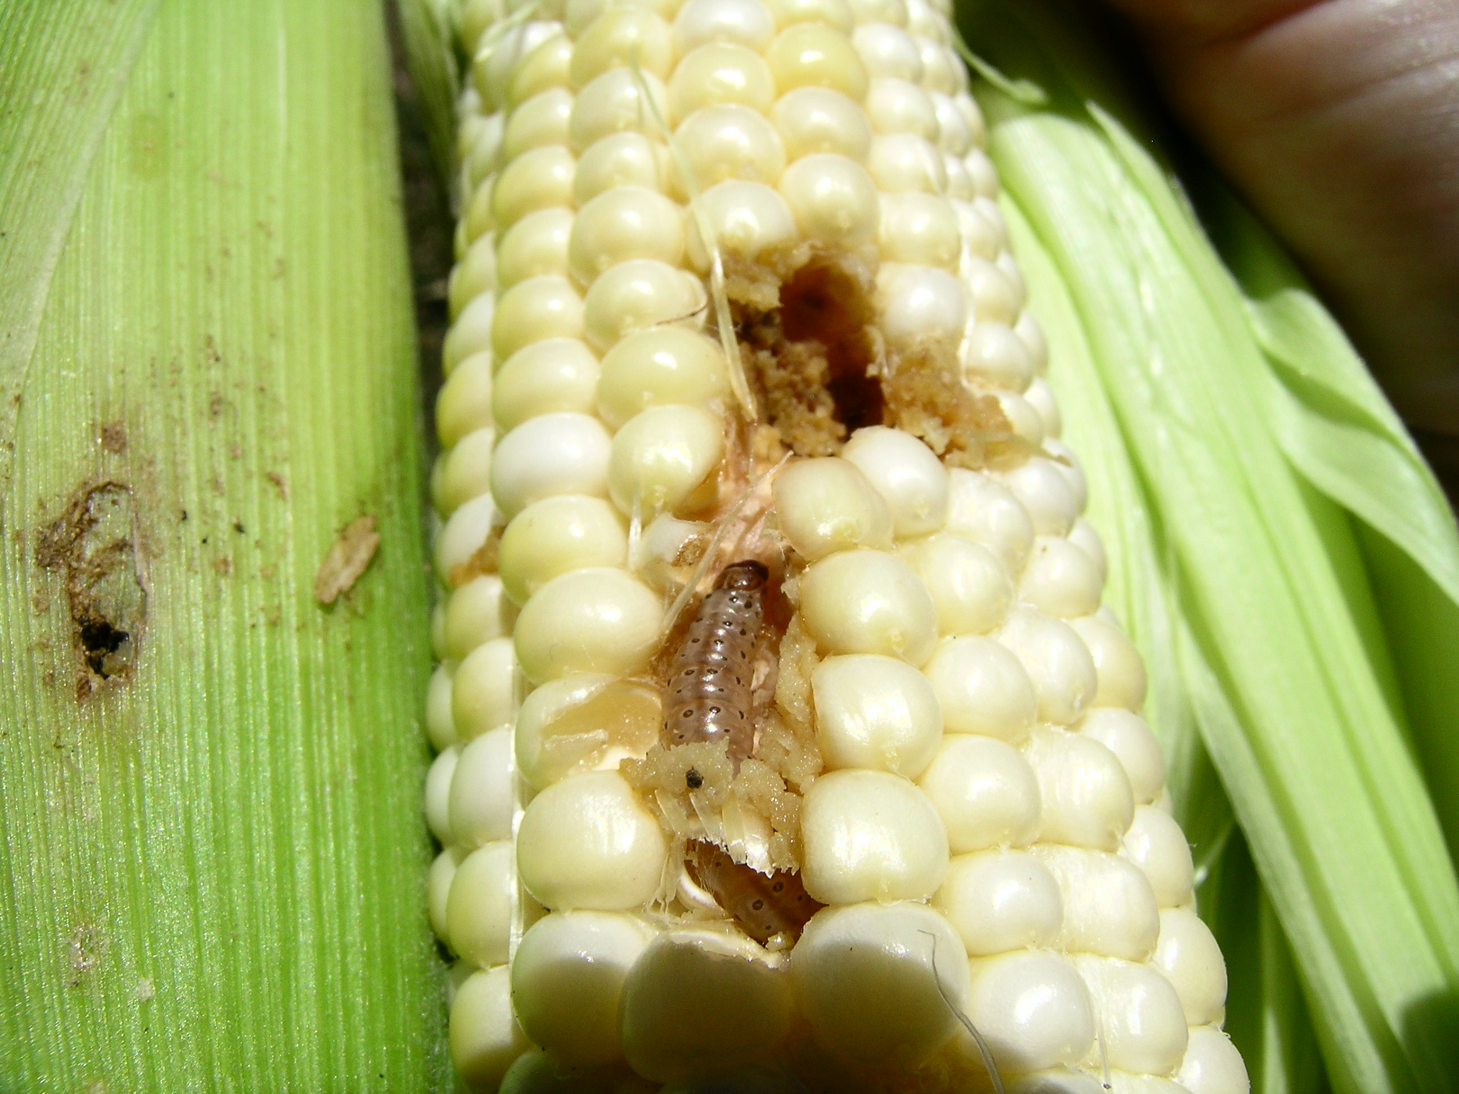
Diapause
Programmed period of suspended development
Synchronizes insect life history with their environment
Suppressed Metabolism
Triglycerides
Carbohydrates
Proteins

Slide 5
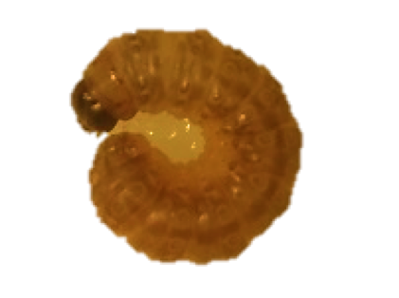
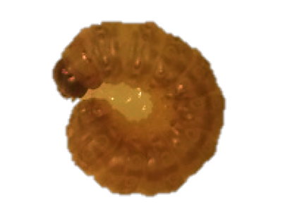
Two Genotypically Distinct Polymorphisms of ECB
Univoltine-Z Strain:
1 annual generation
Long Facultative Diapause
Bivoltine-E Strain:
2 annual generations
Shorter Facultative Diapause

Slide 6
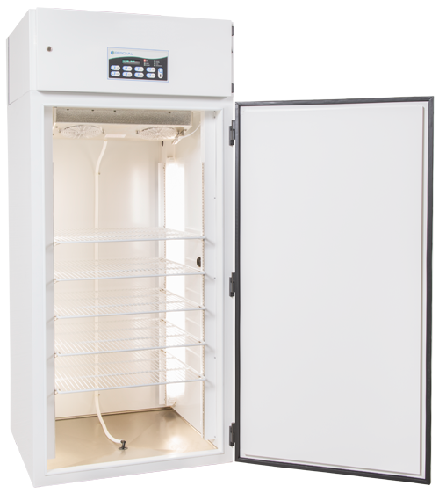
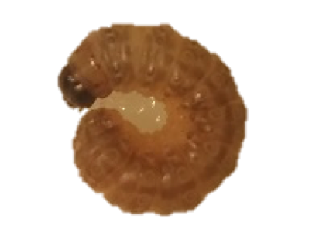
Hypothesis: Longer diapausing ECB accumulate more triglycerides than the shorter diapausing and non-diapausing ECB.
Summer
Fall
Notes:
Diapause initiation and genetically pre-determined diapause length dictate the accumulation of resources

Slide 7
?
Shared Developmental Stage
Diapause
Non-diapause
Diapause and non diapause larvae enter wandering stage
Wandering stage larvae terminate feeding
Stored resources at their peak during wandering stage
WANDERING STAGE

Slide 8
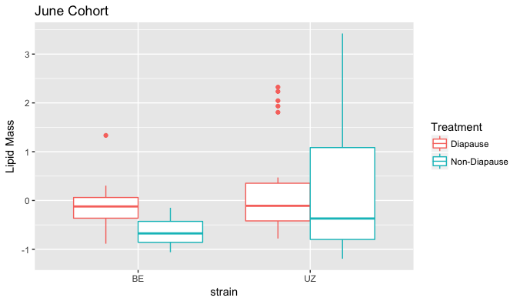

Slide 9
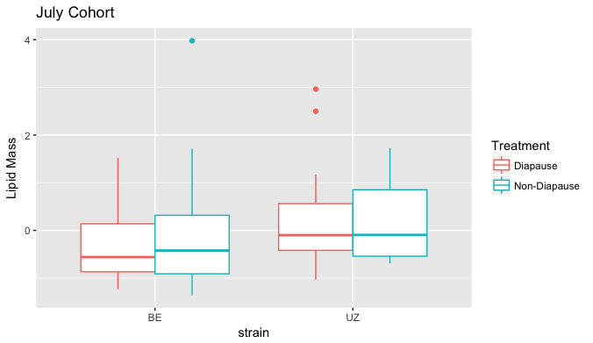

Slide 10
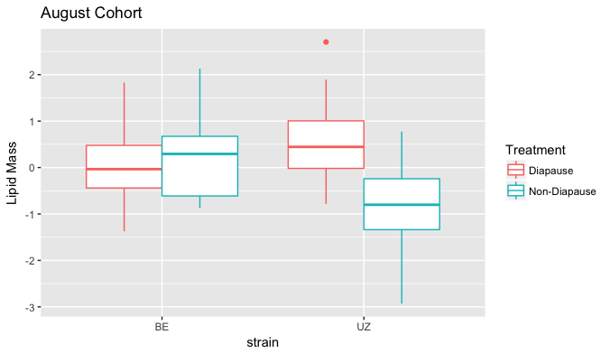

Slide 11
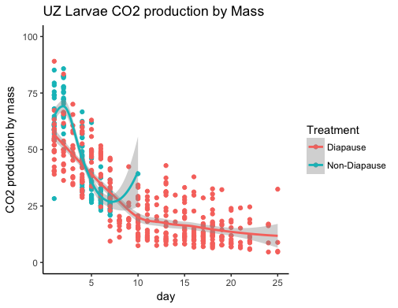
Beginning of 5th Instar

Slide 12
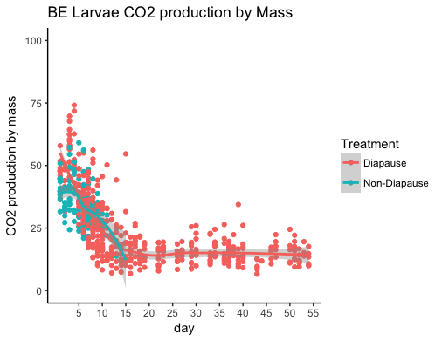
Beginning of 5th Instar

Slide 13
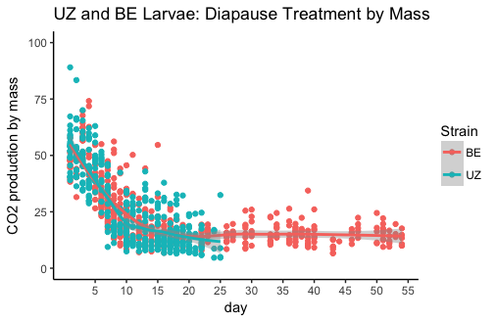

Slide 14
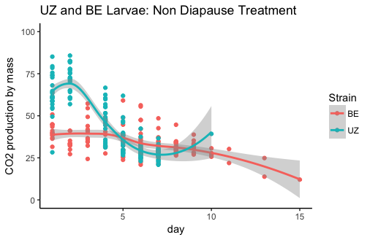

Slide 15
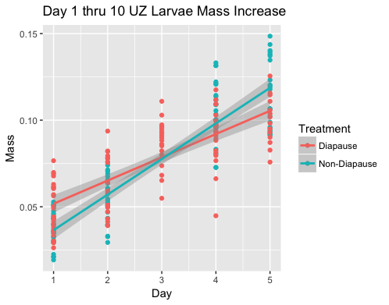

Slide 16
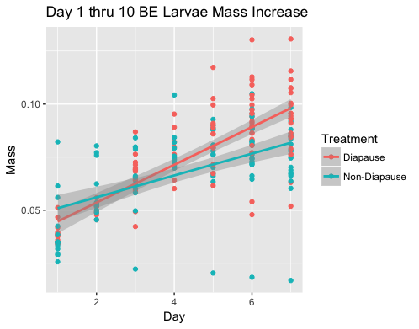

Slide 17
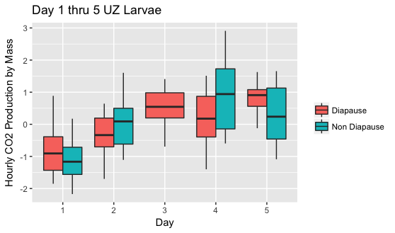
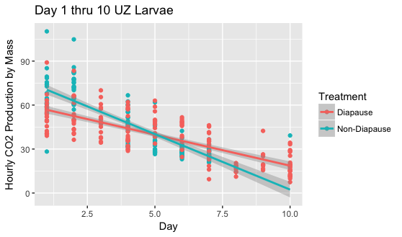
B
B
A
A
A
A
A
A

Slide 18
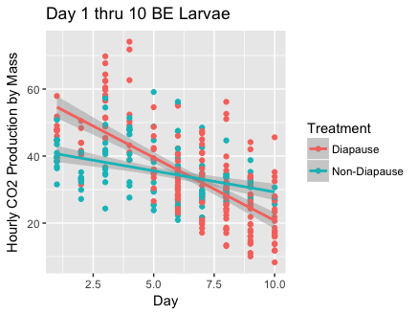
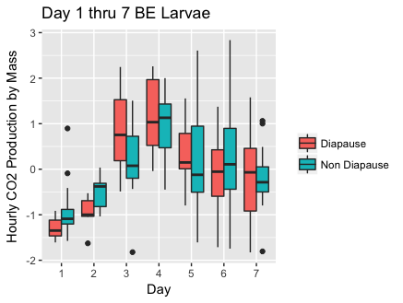
A
A
B
B

Slide 19
Future
Question:
Can CO2 production be used as a proxy for diapause induction or induction?
Question:
What is the degree to which naturally occurring populations vary for diapause incidence under field conditions?
Question:
How will increased temperatures effect the diapause incidence in natural populations?

Slide 20
HTMLs with statistics:
BE_Respirometry
UZ_Respirometry
Combined_Diapause
Combined_Non Diapause

